Slide 1

Universal Analytics Data Backup

Slide 2
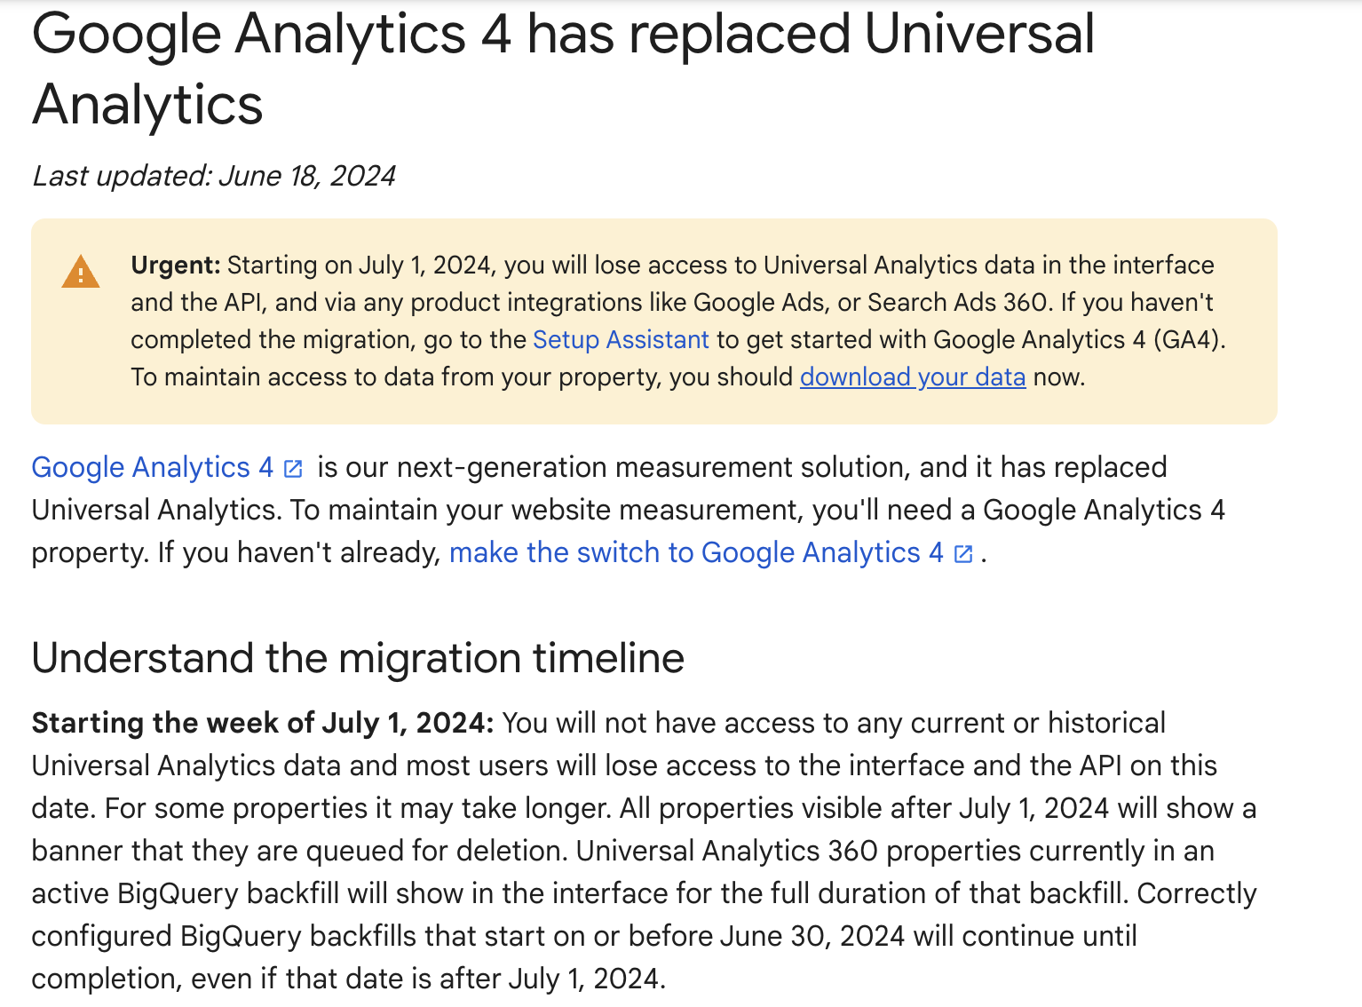
Context

Slide 3
Objectives
To back-up valuable historical data in raw format to be used for future analysis and comparisons.
Methodology
Existing Methods of Data Extraction:
Manually through UA platform on each report page
UA Query Explorer
Third Party SAAS Providers (e.g Funnel.io [1], mamoto [2])
Google API + Python to save csv files locally
Limitations
Limitations according to the above list of methods:
Time Consuming, Tedious and Possible Data Loss
Time Consuming, Tedious and Possible Data Loss
Estimated time required for extraction based on data size >1 week
Requires some Technical Knowledge
Pricing information for Funnel.io can be found here.
Pricing information for mamoto can be found here.

Slide 4
Google API + Python
Basic Info
Uses Google Analytics API and Python
Extracts a sample of all data based on the date range, metrics and dimensions specified and outputs it in a .csv file
Limitations
The actual raw data for Singapore has hundreds of millions of rows of entries, hence sampling is necessary. However, sampling only pulls about 450-500k rows of data out of tens of millions of entries at a time. Malaysia and Thailand are less affected by this issue
‘bounceRate’ is calculated based on individual pages/sites, which is not representative of the actual bounce rate for the whole website, so we added an extra metric i.e. ‘bounces’ for more accurate calculation of bounce rate
e.g Average Bounce Rate for a given day should not be calculated by taking the average of bounceRate, instead should be calculated by $\frac{SUM Bounces}{SUM PageViews} x 100\%$
Metrics
sessions | sessionDuration | avgSessionDuration
users | newUsers | bounceRate
pageviews | uniquePageviews | bounces
Dimensions
sessionCount | pagePath
deviceCategory | pageTitle
source | medium
date

Slide 5
Google API + Python
Data Overview
 | Date Range | Sample Size | Total Number of Rows of Data
Singapore | 2015-01-01 to 2023-06-30 | 477084 out of 25264277 | 737864
Malaysia |  | 488870 out of 514231 | 390297
Thailand |  | 499436 out of 1289823 | 305879

Slide 6
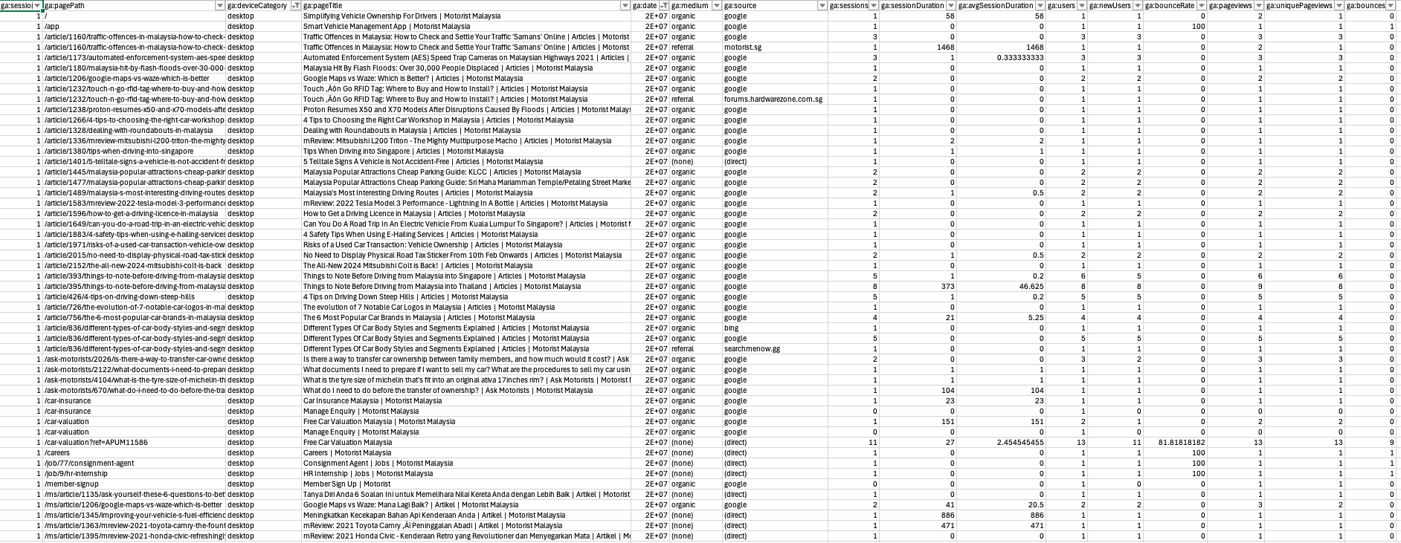
Google API + Python
Snapshot of Data
Link to the google drive folder containing the csv exports can be found here.

